Slide 1
“Antimicrobial effect of Sage (Artemisia tiripartita, and Artemisia trifida) against Candida albicans, E. coli and Staphylococcus aureus spp.” Faylene Begay, Diné College School of STEM, Tuba City, Arizona

Slide 2
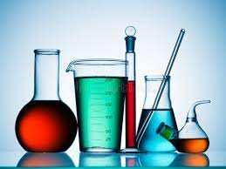
This is a scientific experimental study to be conducted By Faylene Begay BS Psychology, BS Biomed Sciences (in progress) For the MS Biology Thesis Research (in progress) Thesis Supervisor: Prof. Dr. Shazia Tabassum Hakim PhD. Microbiology School of STEM, Biomedical Sciences Department, Diné College, Tuba City campus (Supported by: NSF-TCUP-ICE-TI-2202023) (NNR-23.484)

Slide 3
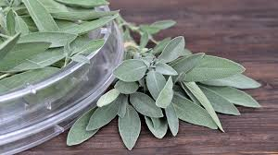
Background:
Sage (salvia officinalis L.) is a native plant and a medicinal herb that grows on Dine’ lands. Approximately 900 species have been identified globally having beneficial components that could help the world, like they have been used in Dine’ societies.

Slide 4
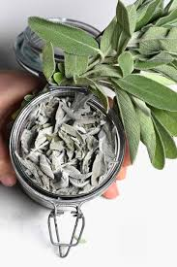
Aims & Objectives
To check the effectiveness of sage when soaked in water, ethanol, methanol or acetone.
Two types of sage: Artemisia tiripartita, and Artemisia trifida which grows in Southwest regions and are frequently used by Navajo people will be used.
We will check how good these extracts of sage will work against a yeast called Candida albicans, and bacteria for example E. coli and Staphylococcus aureus as a possible antibiotic compound

Slide 5
Material & Methods:
Testing methods to be used
Broth dilution method
Agar plate method, and
Kirby Bauer’s disk diffusion method
Broth dilution is a standard method to determine Minimal Inhibitory Concentration (MIC)
These three methods are simultaneously being used to compare and help determine more accurate efficacy of our test compounds

Slide 6
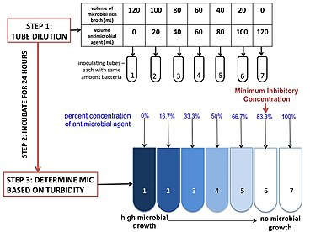
Broth Dilution Method:
1. Soak sage leaves in water,
ethanol, methanol and
acetone.
2. Mix test bacteria or yeast
with different dilutions of
sage extract and see if test
bacteria or yeast grow or
not
3. Look for cloudiness: more
cloudiness bacteria present;
clear solution no bacteria

Slide 7
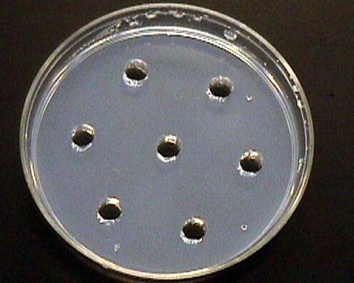
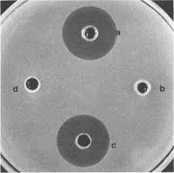
Agar well Diffusion Method

Slide 8
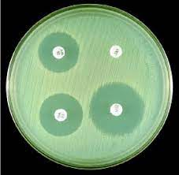
Kirby and Bauer’s
Disc Diffusion
Method

Slide 9
With the current knowledge about sage plants, it is believed that the sage plant’s extracts would be a good addition to antimicrobial medicines against infections caused by bacteria and yeast and help fight antibiotic resistance.
By making extracts in different solvents like ethanol, methanol, acetone or water will help us determine the chemical nature of the actively effective component of sage

Slide 10
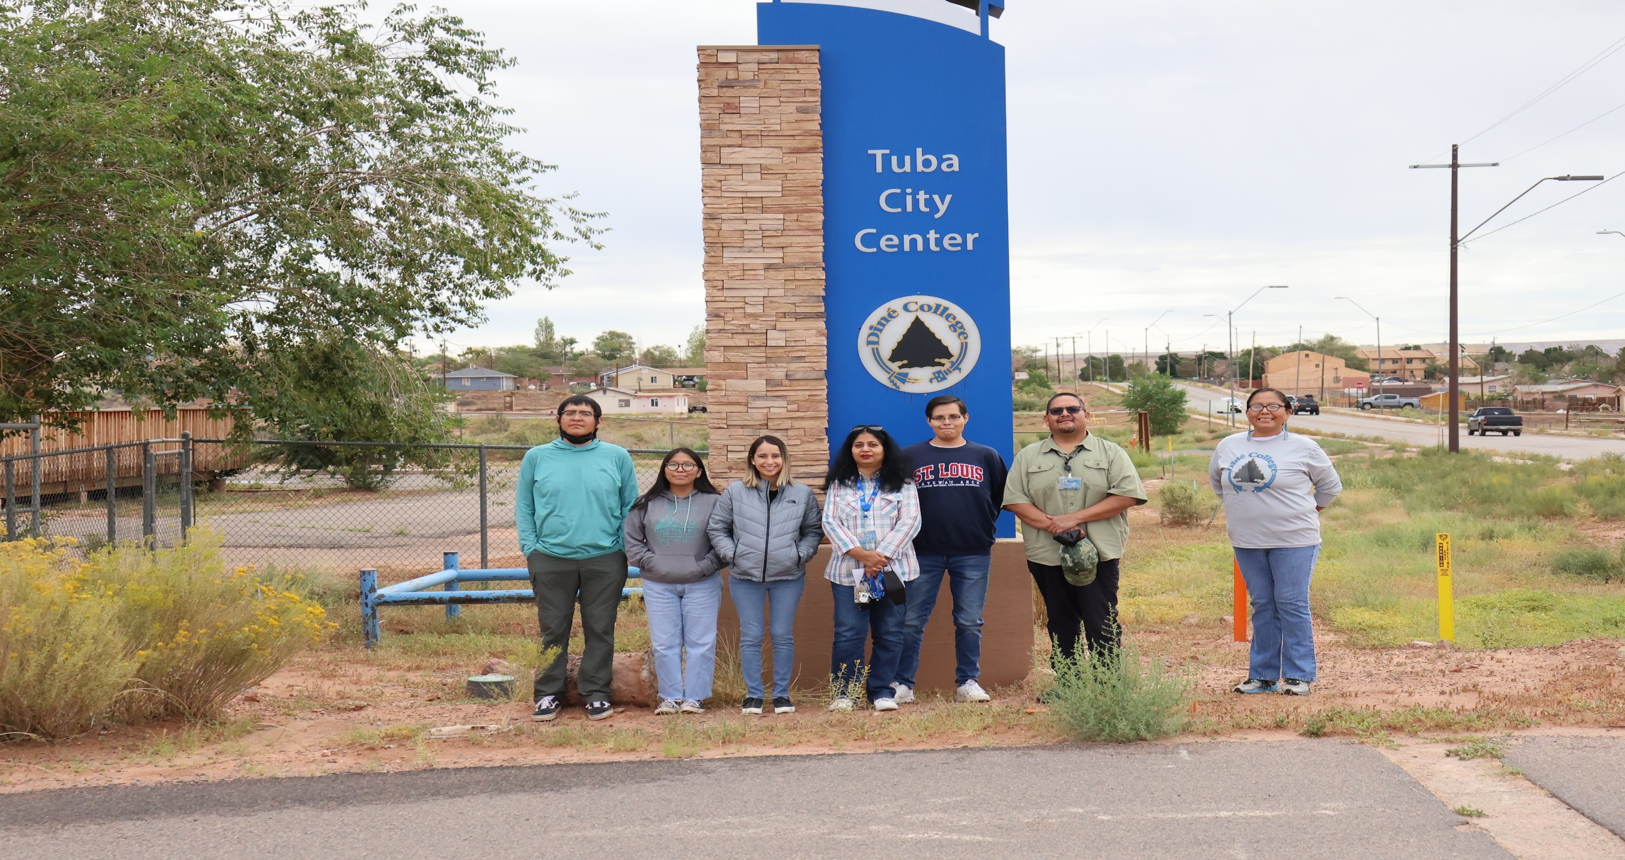

Slide 11
Thank you!

